Slide 1
Linear Algebra
Lecture 3

Slide 2
Systems of
Linear Equations

Slide 3
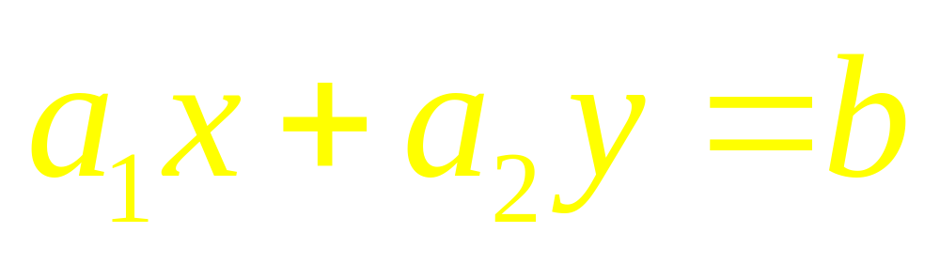
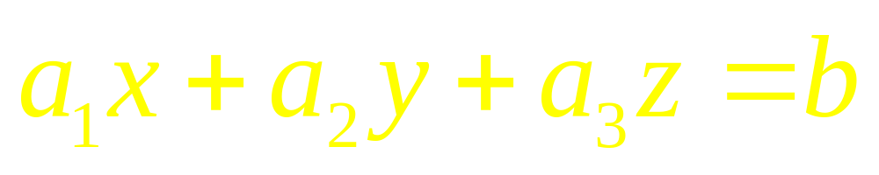
Examples of
Linear Equations

Slide 4
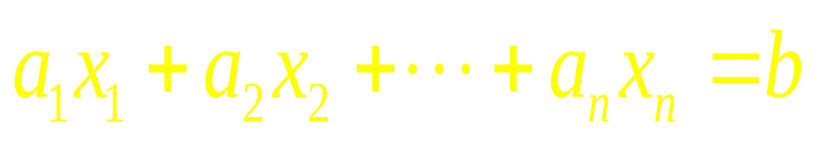
Generally
An equation in n-variables
or in n-unknowns

Slide 5
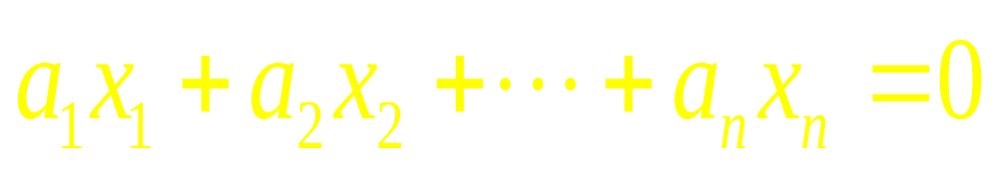
Homogenous
Linear Equations
If b=0

Slide 6
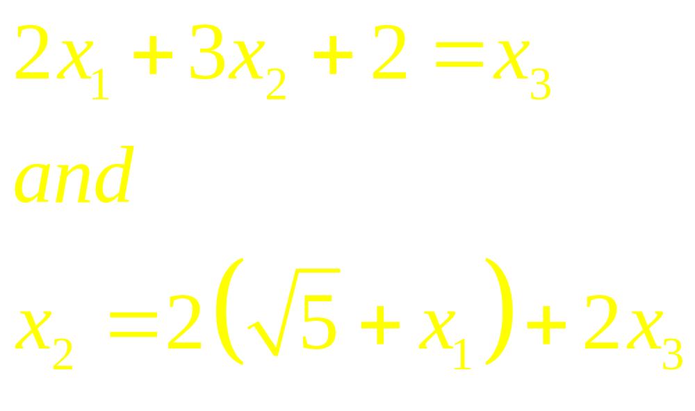
Examples of
Linear Equations

Slide 7
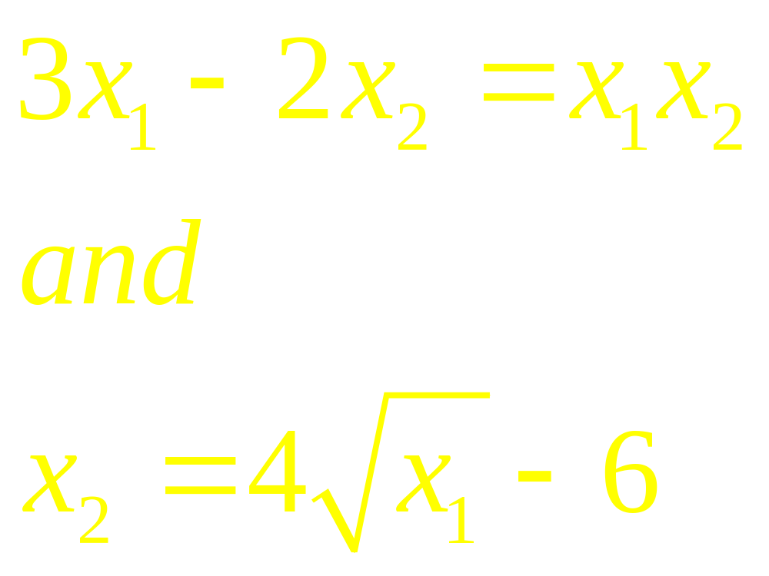
Non Linear Equations

Slide 8
Linear System
A finite set of linear equations is called a system of linear equations or linear system. The variables in a linear system are called the unknowns.

Slide 9
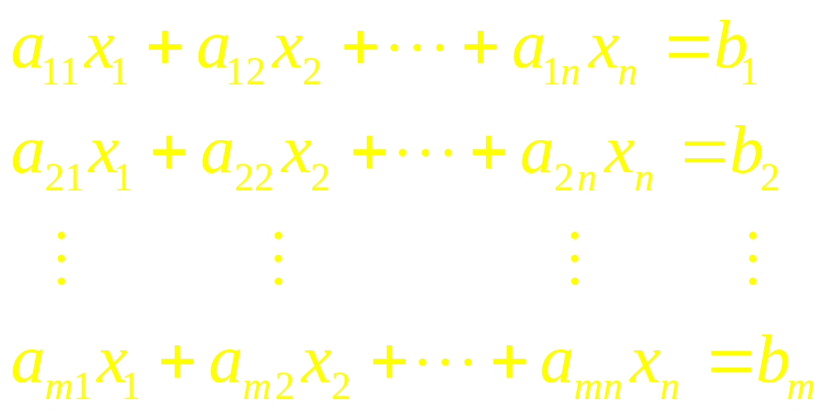
Linear System

Slide 10
Theorem
Every system of linear equations has zero, one or infinitely many solutions; there are no other possibilities.

Slide 11
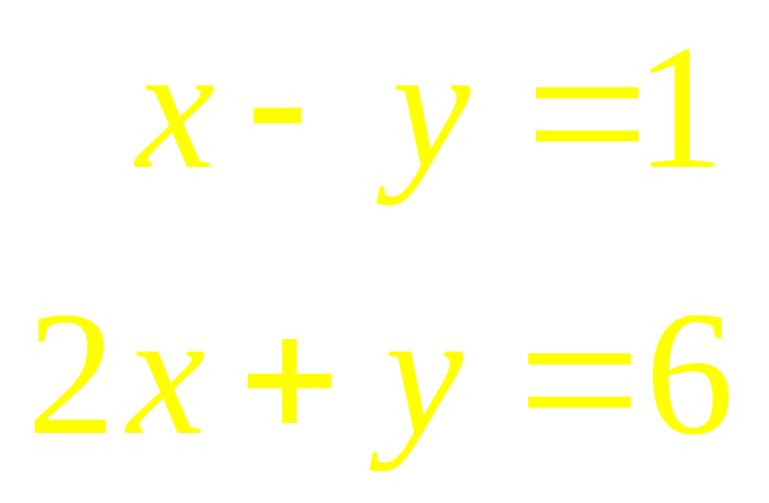
Example

Slide 12
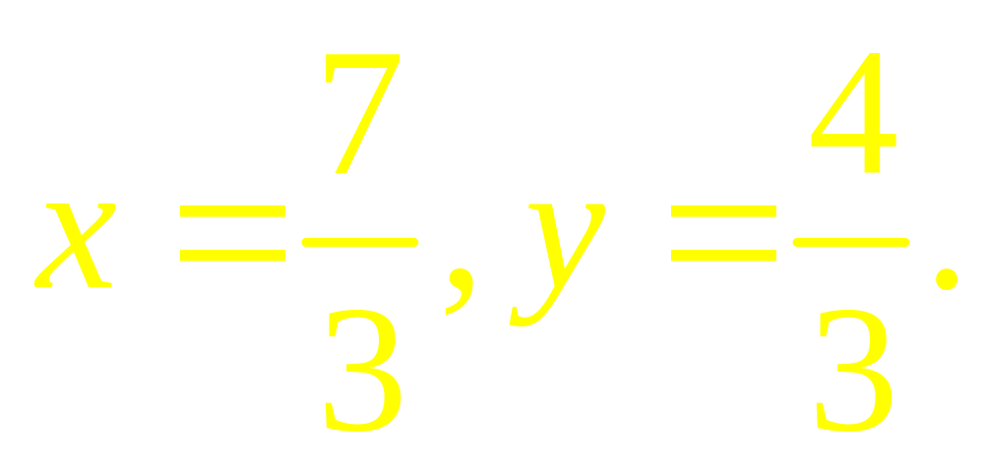
Example (answer)

Slide 13
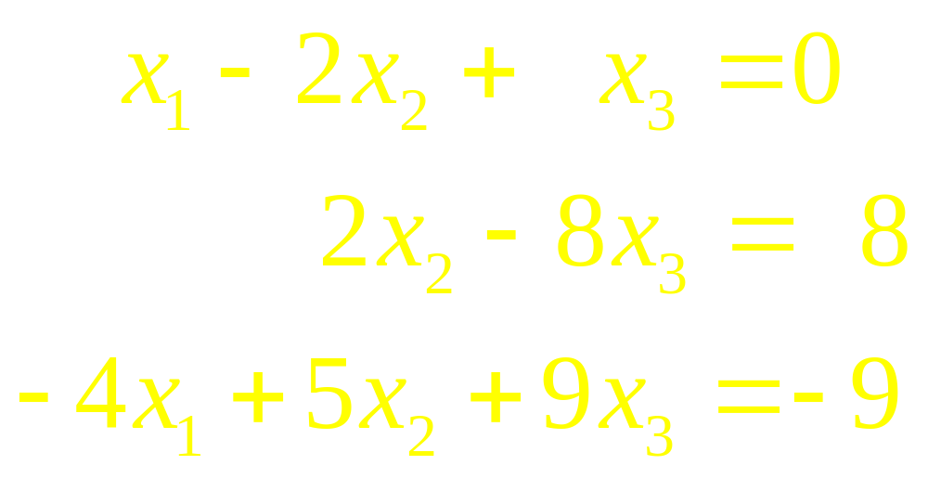
Matrix Notation

Slide 14
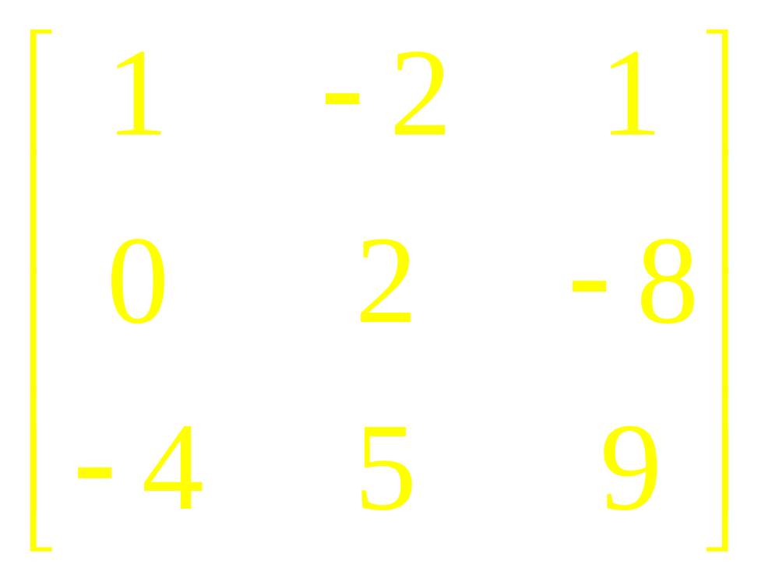
Matrix Notation
Matrix of Coefficients

Slide 15

Example
Solve

Slide 16
Example
Test the Consistency

Slide 17
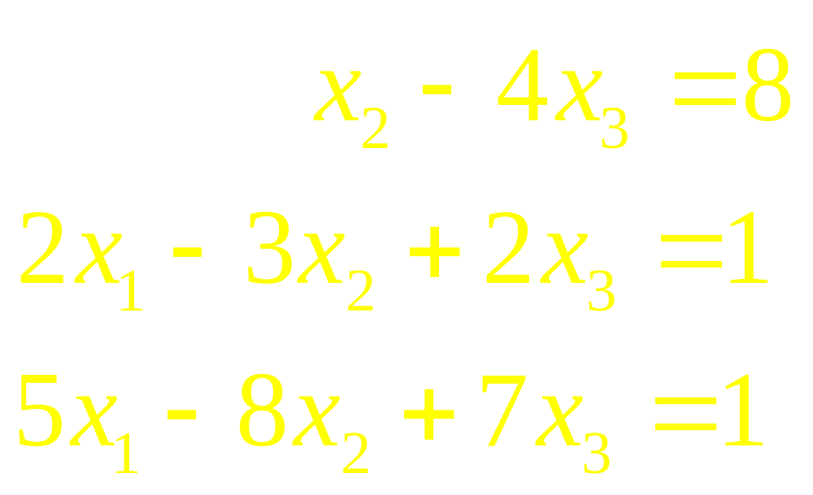
Example
Test the Consistency

Slide 18
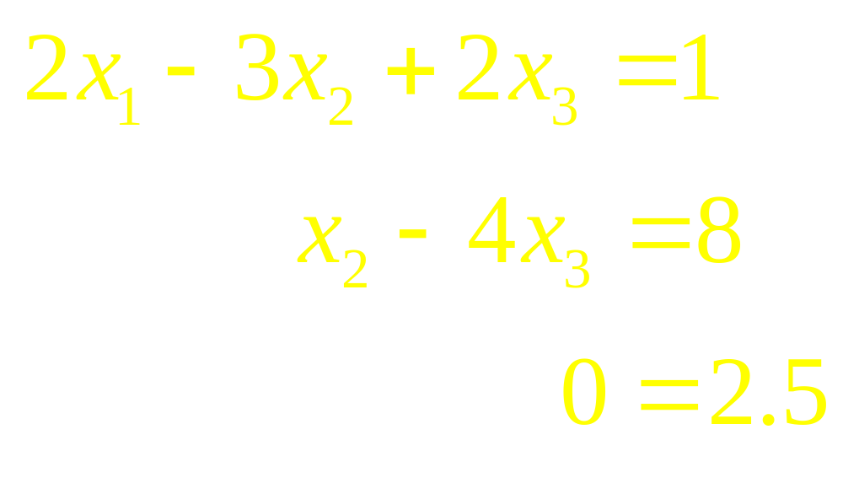
Example (Solution)
Inconsistent !
So: NO SOLUTION

Slide 19
Linear Algebra
Lecture 3

